Slide 1

Customer Churn Prediction
Using improved balanced random forest

Slide 2
Outline
Problem Statement
Previous Work
Solution Proposed
Dataset
Evaluation Criteria
Future Work Proposed

Slide 3
Problem Statement
Churn prediction is a major issue for companies in this competitive environment these days where their aim is to retain as many customers as possible by satisfying their needs. This problem is addressed and a novel data mining algorithm is presented to predict churning in imbalanced dataset conditions.

Slide 4
Previous Work
Decisions tree: vulnerable to noise and some leaves can have same class probabilities, also overfitting.
Neural Networks: cannot express uncovered patterns in a easy way.
Genetic Algorithms: cannot predict likelihood associated with their prediction.
Random Forest: Doesn’t work well when data is highly unbalanced.

Slide 5
Limitations of the existing approach
The data provided is imbalanced and the number of churned customers constitutes a minority of the dataset.
Large applications will definitely have some noise in the dataset.
Predicting churn requires ranking of customers based on their likelihood to churn.

Slide 6
Solution Proposed
Combination of weighted (cost sensitive learning) and balanced random forest( sampling). Both improve the prediction accuracy of minority class when the data is highly unbalanced but have their limitations.

Slide 7
Weighted Random Forest
A weight is assigned to each class and a higher weight is given to minority class and high penalisation in case of misclassification.
Also features are given a random weight and at each node all the features are considered for selection.
Hence computationally inefficient and also very vulnerable to noise.

Slide 8
Balanced Random Forest
Either the majority class is downsampled or the minority class is upsampled , however the downsampling gives better results.
Certain number of data belonging to minority class is selected and similar no of data is drawn from majority class. Results in loss of data.
It is computationally efficient and noise tolerant but doesn’t produce any significant improvement in classification.

Slide 9
IMPROVED BALANCED RANDOM FOREST
Interval variables m and d are introduced which are initialised to 0.1 and varied to find the optimal performance.
𝝰 ( Distribution Variable ) is generated for each tree ranging from m-d/2 to m+d/2.
Draw n𝝰 samples from positive class and n(1-𝝰) samples from negative class and assign weights (1-𝝰) and 𝝰 respectively.

Slide 10
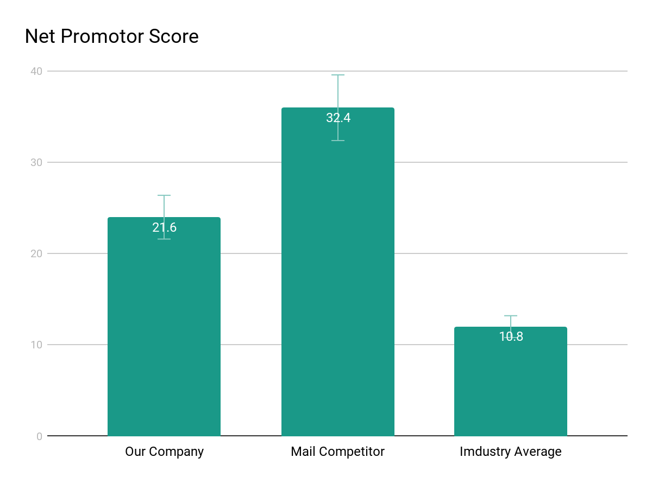
Supporting information
01
1
List any research or data you have to support the need for a solution.

Slide 11
Supporting information
02
82%
Users are constantly searching for a solution
Explain why you’re focusing on a particular part of the problem or a particular subset of users.

Slide 12

Supporting information
03
Julia
Team Manager
Reference your personas, if you have them.
Describe the content of Julia’s job and the problem she and her team are currently facing.

Slide 13
Use cases / user stories
Use cases, user stories, notes to set up the wireframes. Such as…
“As an Administrator, I would like to restrict permissions based on role.”
“As a Moderator, I would like to flag and approve comments.”
Executives indicated that being able to see a summary of each segment of data was their #1 priority.
Note: secondary admin workflow not planned for this release.

Slide 14
Assumptions
State your assumptions or any unknowns here.

Slide 15
Solution Proposal

Slide 16
Solution description
Now that you’ve justified your attention to the problem, summarize your solution in one or two sentences.

Slide 17
Why it’s better than existing solutions
Return to the problem now that you’ve introduced your solution. Compare your solution to others and describe how it is superior.

Slide 18
Wireframes

Slide 19
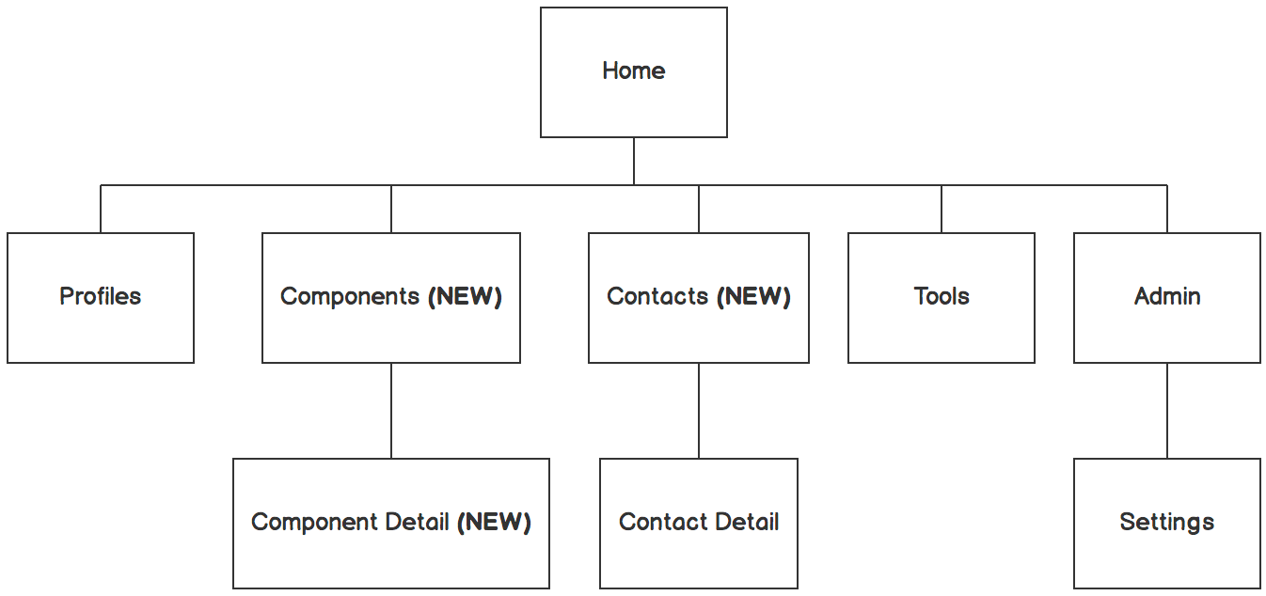

Information architecture
Balsamiq Tip | Information architecture is the flow of content across the site or application (more info).

Slide 20
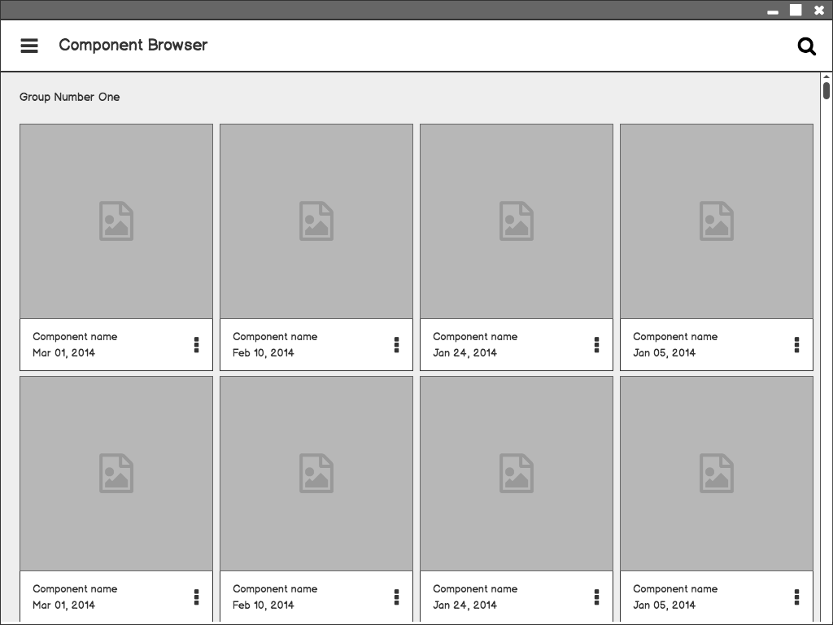
Component Browser
Call out key parts of the UI
Balsamiq Tip | Use the Balsamiq add-on to make your own wireframe.

Slide 21
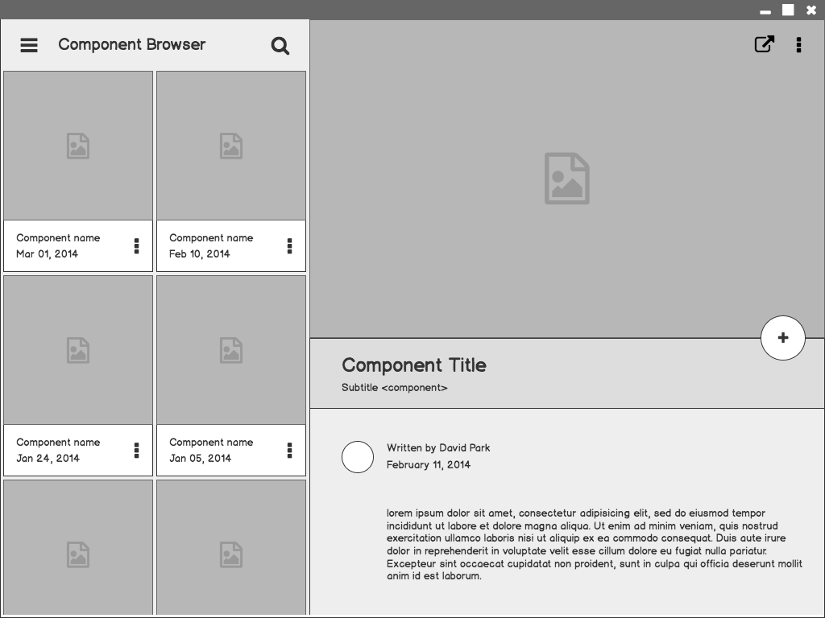
Component Detail

Slide 22
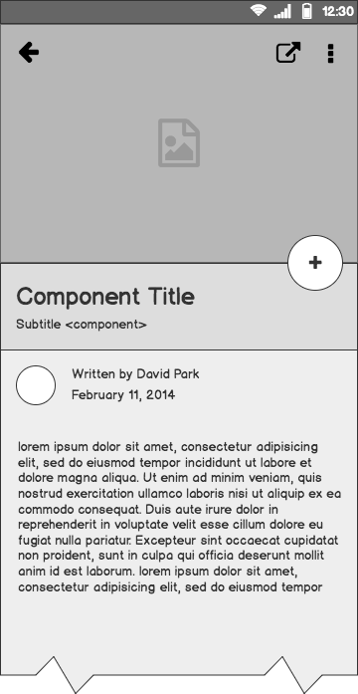
Component Detail (Mobile)
Articulate your design decisions by adding justifications

Slide 23
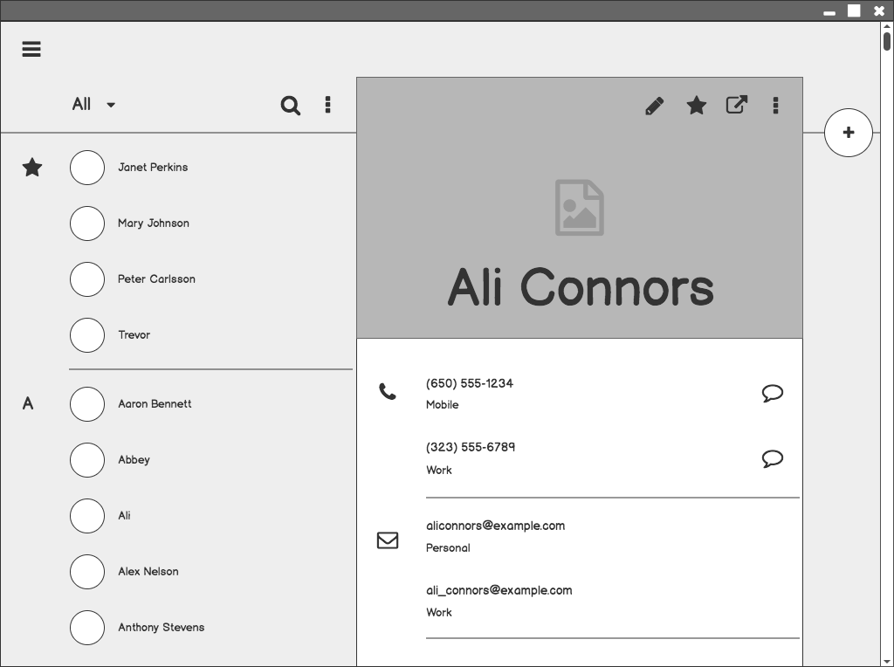
Contacts

Slide 24
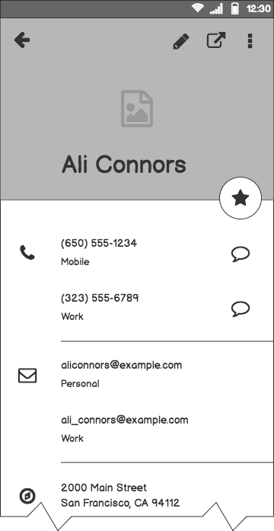
Contacts (Mobile)

Slide 25
Next Steps

Slide 26
What next?
Present the timeline.
Solicit comments on these slides or reviews on these wireframes in the Balsamiq add-on.
User testing plan.

Slide 27
Timeline
MAY
JUN
TODAY
AUG
SEPT
OCT
NOV
Requirements gathering
User research
Wireframes
Review
Prototype
User testing
Dev hand-off

Slide 28
Questions?

Slide 29
References
Tips for Presenting Your Wireframes
3 Steps to Better UI Wireframes
Wireframing for Beginners

